Slide 1
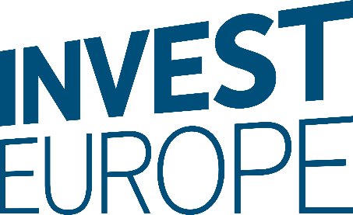
MID-MARKET PRIVATE EQUITY
EUROPE’S ENGINE
FOR GROWTH
February 2022

Slide 2
Disclaimer
The information contained in this report has been produced by Invest Europe, based on data collected as part of the European Data Cooperative (EDC) and other third-party information. While Invest Europe has made every effort to ensure the reliability of the data included in this report, Invest Europe cannot guarantee the accuracy of the information collected and presented. Therefore, Invest Europe cannot accept responsibility for any decision made or action taken based upon this report or the information provided herein.
This report is for the exclusive use of the persons to whom it is addressed and is intended for general information purposes only. It is not intended to constitute legal or other professional advice and should not be treated as such. Appropriate legal advice must be sought before making any decision, taking any action or refraining from taking any action in reliance on the information contained in this report. Invest Europe does not assume any responsibility for any person’s reliance upon the information contained herein.
In furnishing this report, Invest Europe undertakes no obligation to provide any additional information or to update this report or any additional information or to correct any inaccuracies which may become apparent.
Unless otherwise specified, this report is confidential and may not be distributed, published, reproduced or disclosed to any other person or used for any other purpose, without the written permission of Invest Europe.
Copyright information
No part of this publication may be reproduced by any process except in accordance with the provisions of the Copyright Act 1968.
Copyright enquiries should be directed to Invest Europe.
Tel: + 32 2 715 00 20.
© Copyright Invest Europe February 2022
Version
Presentation as of 23/02/2022

Slide 3
Contents
FOREWORD | 4
OVERVIEW | 5
Introduction to the European Mid-Market | 6
MID-MARKET FUND PROFILES | 23
Mid-Market funds active at any point from 2007-2020 | 24
Investment patterns | 25
Sources of capital & investable reserves | 33
CASE STUDIES | 38
Biolchim | 39
NKD | 40
Purcari Wineries | 41
REPA Group | 42
APPENDIX | 43
Definitions & source of data | 44
Acknowledgements | 45
About Invest Europe | 46
€144 billion
invested by Mid-Market funds into European companies, 2016-2020
3,320
MID-MARKET FUND PERFORMANCE | 11
Financial performance | 12
Social performance (employment) | 17
European companies invested into by
Mid-Market funds, 2016-2020
€223 billion
Capital under Management of Europe focused Mid-Market funds in 2020

Slide 4



Foreword
Across the continent, Mid-Market private equity firms & funds are professionalising businesses, creating jobs, driving innovation, championing sustainability and expanding company horizons.
At the same time as building better businesses and laying the foundations for a stronger and more competitive Europe, funds are consistently delivering superior returns to long-term investors, which in turn supports the savings and retirements of millions of European citizens.
The Mid-Market is a critical link in European private equity’s value creation chain. In some ways, it is the industry’s unsung hero. Accelerating venture capital investment in start-ups and large buyout transactions for big brand name businesses often generate the biggest headlines. Yet, Mid-Market private equity is where the rubber meets the road as firms take entrepreneurial companies and set them on the path to being European and global success stories.
Invest Europe’s Mid-Market report brings new focus to this broad, varied and dynamic private equity segment:
It demonstrates the Mid-Market’s critical role
in supporting companies across Europe;
It shows how returns from European Mid-Market funds are outperforming other segments, and other regions;
It also highlights the segment’s outperformance on employment and at rates far in excess of European business averages;
Finally, our study also tracks the regions and industry sectors where funds are investing, as well as rising fundraising levels as investors, including pension funds, insurers and funds of funds target more capital at this space.
This is the first in Invest Europe’s new generation of Mid-Market reports. We will regularly update and expand our research to provide more insight into this central part of the European investment ecosystem. In doing so, we will highlight the achievements of Mid-Market private equity funds and demonstrate why they represent an opportunity not to be missed by investors.
Eric de Montgolfier
Chief Executive Officer
Frans Tieleman
Vice-Chair, Mid-Market
Platform Council
Across the continent, Mid-Market private equity firms & funds are professionalising businesses, creating jobs, driving innovation, championing sustainability and expanding company horizons.
Eric de Montgolfier
Chief Executive Officer

Slide 5
Overview
MID-MARKET PRIVATE EQUITY

Slide 6
Introduction to the European Mid-Market
Mid-Market funds, by the numbers
A growing, globalised world relies on a strong Mid-Market.
Many of the companies that lead the world today in technology, healthcare, business services or consumer goods have their roots in small and medium-sized businesses created in recent years and decades. So, it stands to reason that the global business champions of tomorrow can be found in the Mid-Market today, developing the products and services that will be indispensable to companies and consumers
in the future.
European Mid-Market private equity is broad
and heterogeneous. There are funds focused on specific sectors or countries, while others take
a pan-European approach across multiple industries. Some funds concentrate on Buyouts and others on Growth investments and minority stakes. There are funds dedicated to smaller, local businesses, while others target larger companies that have already started to develop internationally. And there are funds that invest in Mid-Market companies that are underperforming or facing failure with a view to turning them around.
While varied, what all funds in Europe’s
Mid-Market share is private equity’s sharp
focus on building better businesses through
the application of deep and wide expertise, hands on operational improvement, and
capital investment.
The Mid-Market forms a large part of the
private equity ecosystem in Europe. Of all
the funds that have had a focus on Europe
since 2007, 1,279 fit within the Mid-Market
space and of those, 1,044 of these were
still active in 2020.
17.01%
€144 billion
net IRR return vs. 14.88% for European large and mega buyouts and 7.07% for MSCI Europe (mPME)
invested by Mid-Market funds into European
companies, 2016-2020
+6.4%
3,320
2018-2019 job creation rate vs.
+0.9% all European businesses
European companies invested into by
Mid-Market funds,
2016-2020
€137 billion
€223 billion
raised from 2016-2020
vs. €83 billion 2011-2015
Capital under
Management in 2020

Slide 7
Mid-Market funds with a focus on Europe
Mid-Market funds with a focus on Europe 2007-2020¹
There is significant diversity within Europe’s
Mid-Market. While a good proportion of
Mid-Market funds concentrate on Buyouts,
there are also lots of possibilities for LPs to
invest in funds with Generalist and Growth strategies that are focused on investments
with a Mid-Market ticket value² of €15m-150m.
Active in 2020
1,044
Inactive in 2020
235
‘Inactive’ refers to funds that had ceased operations before 2020. The sum of active & inactive funds seen here is the universe of funds under study in this report when Invest Europe / EDC data is used
1
€ value of equity investment made by a single firm/fund
into a portfolio company
2

Slide 8
The attractions of Europe’s large market
European Mid-Market private equity operates
in a unique space. The domestic market is
large, with companies serving a population of almost 750 million across the broader European continent, including almost 450 million within the EU – one of the world’s largest free trade blocs.
Ambitious Mid-Market companies have the potential to expand across the region, adapting products
and services for other local markets, or leading consolidation in fragmented industries.
Mid-Market private equity companies are not constrained by their economic surroundings but liberated by them. What these businesses learn in trading across Europe opens doors to international markets, with Mid-Market businesses often able to penetrate markets in Asia, the Americas and Africa.
There are many other factors that make Europe attractive for companies with global aspirations. The continent benefits from a stable and accommodative political and economic backdrop,
a highly skilled and educated workforce, a well-developed legal framework for businesses, strong capital markets, and high levels of innovation
and entrepreneurship.
Split of Mid-Market funds with a focus on Europe 2007-2020³
750 million
Mid-Market Buyout
population across the broader European continent
828
Mid-Market Generalist
300
Mid-Market
Growth Capital
153
The difference of two seen here compared to the previous graph is due to two funds changing their stated fund stage focus in the EDC database
3

Slide 9
Deep and developed pool of Mid-Market investment targets
The European Mid-Market covers a wide range of businesses across all industry sectors – including fast-growing technology and biotech companies, consumer goods and business services. They also vary in size with equity investments ranging from €15 million-€150 million. However, many general partners also have the capacity – either through their investment strategies or dedicated funds
– to invest under €15 million in companies, allowing them to target dynamic businesses
in the SME space.
Many of these companies share common attributes, such as established customer bases, proven demand for their products and services, and a track record of year-on-year revenue growth. Another factor is their resilience through tough times, thanks to their scale which allows them to recruit and retain top talent, while remaining agile enough to be flexible and adaptable to market conditions.
Small companies, backed by Mid-Market private equity, are an important source of innovation, R&D and product development. Mid-Market private equity can also give businesses a new lease of life. Private equity has a transformative effect on Mid-Market European companies, providing them with the capital, as well as expertise, to open doors and drive them to
the next stage of their development. As such, Mid-Market European private equity gives companies all the tools they need to grow.

Slide 10
Expertise in driving Mid-Market growth and value
European Mid-Market private equity funds are specialists in identifying investments and adding value. Thanks to their deep networks and their long track records, funds can access investment opportunities at relatively low valuations and
plot development plans that increase revenues, profits and multiples over the holding period.
European Mid-Market private equity funds are experienced in pursuing bolt-on acquisition strategies to grow businesses. They are adept
at using knowledge and contacts to enable portfolio companies to internationalise and
build their presence in new markets. They have the skills to help businesses to develop new products and services and they have talent pools to navigate ESG risks and identify opportunities for companies to grow sustainably.
Key ways of growing companies: Buy-and-build – acquiring complementary businesses to increase revenues and multiples
Innovation and R&D – investment in new products and services to reach new consumers
International expansion – taking growing companies into new markets across Europe and globally
Corporate carve-outs – establishing unloved divisions of larger corporates as standalone businesses
Capital investment – new production facilities, technology and new hires to boost performance
Turnarounds – investment in failing mid-market companies to turn them around

Slide 11
Mid-Market fund performance
MID-MARKET PRIVATE EQUITY

Slide 12
Mid-Market fund performance
Mid-Market funds hold onto investments for
just under six years on average, tending to
divest either by trade sale or sale to another private equity firm.
The importance of these two routes reflects
Mid-Market private equity’s essential role in setting medium-sized companies on the path
to enhanced growth and international expansion, and the opportunity for other – often large
Buyout – general partners or corporates to continue that journey.
What can a limited partner typically expect from investing in a Mid-Market fund?
This section looks at two key outcomes of investing into Mid-Market funds: the financial performance as measured by net IRR & MOIC;
and the social performance as measured by employment at portfolio companies.
Divestments at cost 2016-2020
By Mid-Market funds, by exit route (% of € amount)
Sale to another
private equity firm
Trade sale
Public offering
37%
30%
12%
Repayment of
preference shares/
loans or mezzanine
7%
Sale to financial institutions
5%
Management/Owner buy-back
Almost 6
4%
Write off
Other
the average number of
years Mid-Market funds
hold onto investments
3%
2%

Slide 13
Financial performance
^{4,5}
Mid-Market funds are an attractive option
for LPs looking to secure good returns on
their investments. The data in this section show that Mid-Market funds are well positioned on both net IRR and MOIC⁶ measures, comparing favourably against both other geographies and other strategies. The same is true when comparing Mid-Market funds to public markets, where performance again is particularly strong.
Looking at net IRR, performance of funds focused
on the Mid-Market is significant compared to other categories on this measure, including European Large & Mega LBO funds, European small LBO funds, North American LBO funds,
and Rest of World LBO funds.
Net IRR of LBO funds
By size and geography
NB: the definition of Mid-Market funds in this section is based on fund capitalisation as opposed to the equity investments definition found throughout the rest of the publication. See appendix for full explanation
4
Returns in this section are calculated since inception, the data for European LBO funds covers vintage years from 1987 to 2020. For more Performance data see our latest publication:
The Performance of European Private Equity Benchmark Report 2020
5
European
mid-sized LBO
IRR = net internal rate of return. MOIC = net multiple of invested capital (also often referred to as total value to paid-in or TVPI). Please see Invest Europe’s report: Benchmarking Public & Private Markets with the Public Market Equivalent (PME) for a detailed description
6
Source: Invest Europe, based on Cambridge Associates

Slide 14
Financial performance continued
European Mid-Market funds also perform well on the net MOIC measure, only matched by North American LBO funds.
Net MOIC of LBO funds
By size and geography
European
mid-sized LBO
Source: Invest Europe, based on Cambridge Associates

Slide 15
Performance benchmarks
Against their public market equivalent (MSCI Europe), and using the mPME⁷ method, European Mid-Sized LBO funds perform well compared with the public market benchmark, and at a similar level of outperformance as European Large & Mega LBO.
Net IRR and mPME of LBO funds
By size and geography
European
mid-sized LBO
Modified public market equivalent, based on net cash-flows and NAVs. Please see Invest Europe’s report: Benchmarking Public & Private Markets with the Public Market Equivalent (PME) for a detailed description
7
8
The mPME method used for the MSCI Europe benchmark replicates the cash-flows of the corresponding segment by buying and selling indices of assets
8
Source: Invest Europe, based on Cambridge Associates

Slide 16
Performance benchmarks continued
The picture is similar when looking at net MOIC. Here Mid-Market funds achieve a net MOIC
of 1.72x, compared to the benchmark performance of 1.24x.
Net MOIC and mPME of LBO funds
By size and geography
European
mid-sized LBO
8
The mPME method used for the MSCI Europe benchmark replicates the cash-flows of the corresponding segment by buying and selling indices of assets
8
Source: Invest Europe, based on Cambridge Associates

Slide 17
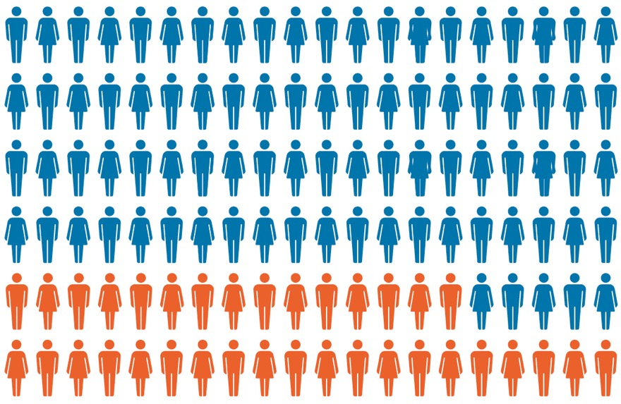
Social performance (employment )
⁹
The social impact of investments is an increasingly important consideration for any LP. This section demonstrates that Mid-Market funds are key players in the European employment market. The portfolio companies they back employ a significant number of people, those companies create more jobs (net) at a rate faster than Europe as a whole, and they are active in a wide range of sectors and geographies.
In 2019, around three million people worked
in companies backed by Mid-Market funds: this represented almost 30% of the total number
of employees working at private equity backed companies – more than the entire population
of Lithuania.
Total employees working in European headquartered
private equity backed companies 2019
Interested in more data on employment or want to know more about the methodology for this section? See our Private Equity at Work- Employment & job creation across Europe
Mid-Market backed
Backed by other private equity
9
3.0 million
7.3 million

Slide 18
Social performance (employment)
Net +98,000 jobs created in 2018-2019
When it comes to creating employment from year to year at European companies, Mid-Market funds far outstrip job creation rates overall on the continent. From 2018-2019 Mid-Market funds created a net +98,000 jobs in the companies
they backed over the two-year period.
Portfolio company job creation rates
Mid-Market funds back companies across a wide range of industry sectors. In 2019, Consumer goods & services along with Business products
& services were the two largest sectors for
Mid-Market fund-backed employment in Europe. ICT and Biotech & healthcare also accounted for important levels of mid-market employment, both exceeding 250,000 jobs.
Job creation rates 2018-2019
Mid-Market backed vs. overall Europe
+98,000
net jobs created in 2018-2019
Source: Invest Europe / EDC & Eurostat

Slide 19


Mid-Market fund backed company employment 2019
 | ^{Number of} ^{employees}
Consumer Goods & Services | 991,505
Business Products & Services | 982,954
Information Communications Technology (ICT) | 290,720
Biotech & Healthcare | 270,876
Construction | 129,476
Transportation | 98,598
 | ^{Number of} ^{employees}
Financial & Insurance Activities | 78,580
Energy & Environment | 53,645
Chemicals & Materials | 35,332
Agriculture | 30,801
Real Estate | 17,822
By sector
By sector
Consumer Goods
& Services
991,505
employees
Business Products
& Services
982,954
employees

Slide 20
A constant need for staff
Each year, the support that Mid-Market funds provide enables companies to develop and grow. That improvement is illustrated in significant increases in net employment levels across the board. From 2018-2019 companies backed by
Mid-Market funds in the ICT sector saw their overall staffing increase by 11% from one year
to the next.
Mid-Market fund backed company employment
growth rate 2018-2019
10
By sector
10
Excludes sectors with <10 portfolio companies

Slide 21
France & Benelux account for one third of jobs
The geographic spread of employment across Europe reflects the importance of Mid-Market private equity in each region of the continent.
In 2019, 33% of total employment at Mid-Market backed portfolio companies was at companies headquartered in France & Benelux.
Total Mid-Market fund backed company employment 2019
By region of company headquarter

Slide 22
High job growth
Employment growth created by Mid-Market funds was strong across all regions from 2018-2019.
Mid-Market fund backed company employment growth rate 2018-2019
By region of company headquarter

Slide 23
Mid-Market fund profiles
MID-MARKET PRIVATE EQUITY

Slide 24
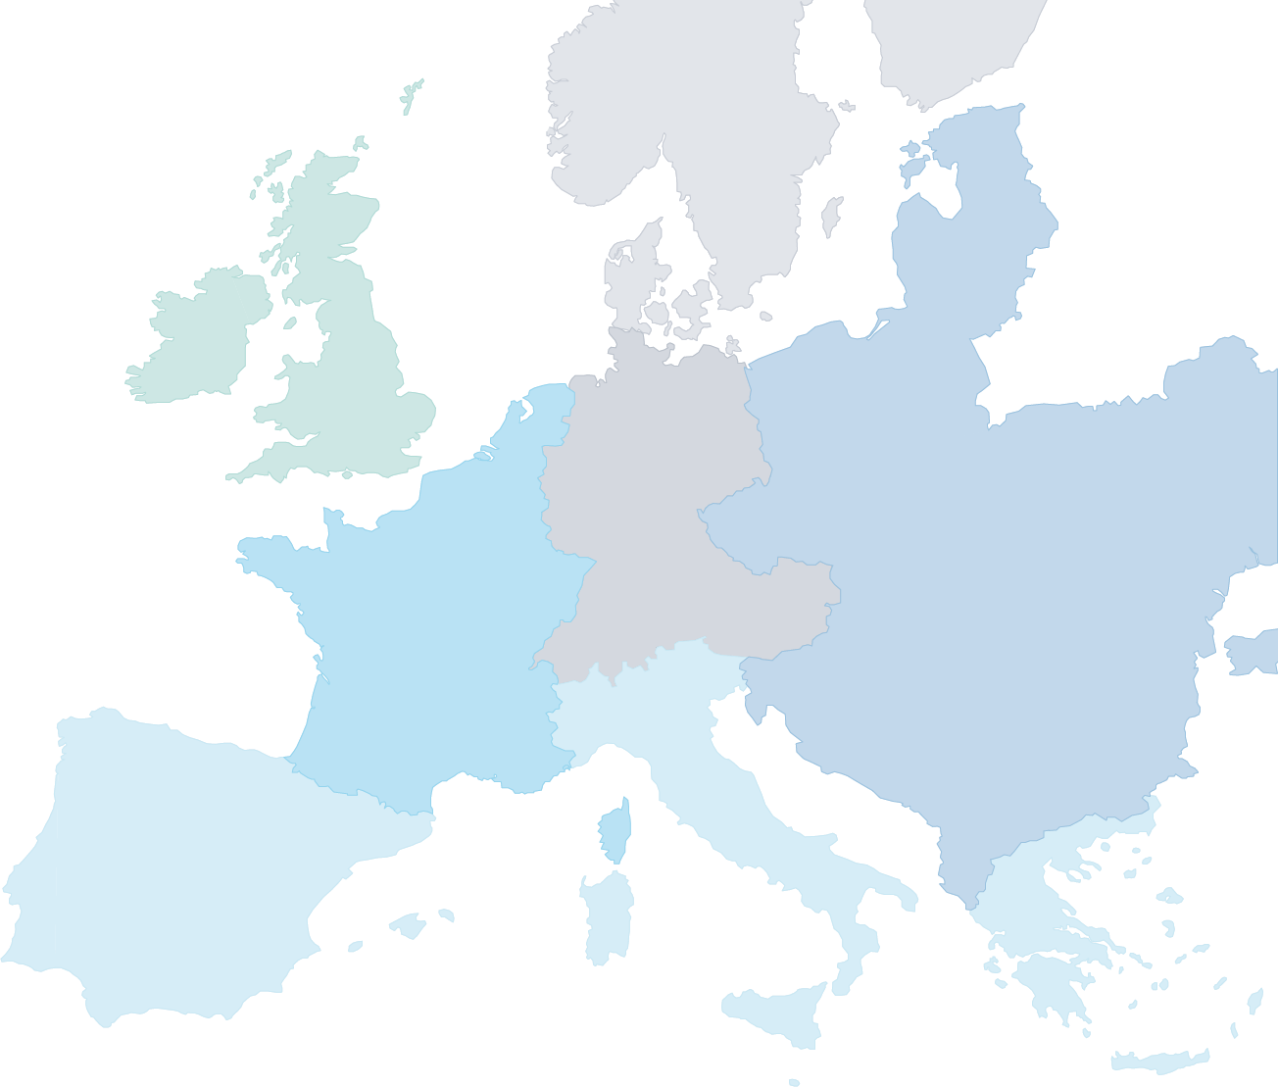
Mid-Market funds active at any point from 2007-2020
By location of advisory team
Nordics
The pan-European presence of Mid-Market funds gives LPs easy access to opportunities across the continent.
Just over 30% of the funds are based in the UK
& Ireland, whilst Mid-Market funds based in
France & Benelux make up over 25%. Most of the non-European funds active in Europe’s Mid-Market are located in the United States.
This next section gives an overview of investment and fundraising profiles of Mid-Market funds.
6%
UK & Ireland
33%
DACH
9%
France & Benelux
27%
Central &
Eastern Europe
33%
1%
of Mid-Market funds are
based in the UK & Ireland
27%
Southern Europe
of Mid-Market funds are
based in France & Benelux
9%
15%
of Mid-Market funds are
non-Europe based

Slide 25
Investment patterns
Although the number of companies that received investments decreased slightly in 2020 compared to 2019, the amount invested by Mid-Market funds into European companies has risen consistently since 2013. Furthermore, while the private equity industry as a whole saw a slight reduction in investment levels in 2020¹¹, Mid-Market funds invested about 7% more than the previous year, demonstrating general partners’ ability to identify attractive opportunities even during
the pandemic.
Mid-Market fund total equity Investments into Europe 2007-2020
By year
Amount (€bn)
Number of companies
11
See our 2020 activity report here

Slide 26
Investment patterns continued
Within the Mid-Market company investment range of €15m-€150m, dedicated Mid-Market funds take the lion’s share of value, accounting for about
70% of the total invested in 2020. Large funds¹², which invest across a range of sizes and segments, are the most significant competitors in this space.
Distribution of total Investments into equity
range €15m-150m
13
By year & focus of fund
12
Large funds = Buyout/Generalist/Growth funds that have >=50%
of their investments in equity range €150-300m
13
Small funds = Buyout/Generalist/Growth funds that have
>=50% of their investments in equity range €0m-€15m;
Large funds = Buyout/Generalist/Growth funds that have
>=50% of their investments in equity range €150-€300m;
Mega funds = Buyout/Generalist/Growth funds that have
>=50% of their investments in equity range >€300m;
Split funds = Buyout/Generalist/Growth funds that don’t have
>=50% of their investments in a specific equity range;
Other funds = Rescue/Turnaround, Replacement capital,
Mezzanine, and Venture funds

Slide 27
Strategic flexibility
Mid-Market funds demonstrate a clear focus
on the core investment range of €15m-€150m,
but also display a flexibility that enables them
to take advantage of opportunities outside of
this range. 77% of the total euro value invested from 2016-2020 by the Mid-Market went into the
€15m-€150m range.
Distribution of total € value of investments of
Mid-Market funds 2016-2020
By size of equity amount invested

Slide 28
Strategic flexibility continued
As seen in the analysis of number of companies receiving investment, Mid-Market funds will often make investments into Small (<€15m) companies when the opportunity arises and fits with the strategy of the fund¹⁴.
Number of companies invested into by Mid-Market
funds, 2016-2020
By size of equity amount invested
14
A contributory factor to the ability of Mid-Market funds to take advantage of opportunities outside of the typical Mid-Market range is the focus of other funds within the same firm of the Mid-Market fund: analysis shows that many firms that have Mid-Market funds also have funds which focus on smaller (<€15m) investment sizes

Slide 29
Investments throughout Europe
Mid-Market funds are present in every region
of Europe, with investment widespread across
the continent. Over the past five years, the UK
& Ireland and France & Benelux have vied for
the position of leading European investment destination. In 2020, these two regions combined received over 60% of total investment by
Mid-Market funds for the year.
Investments, by region, of Mid-Market funds
By year
€34bn
€31bn
€31bn
€24bn
€25bn

Slide 30
Investments throughout Europe continued
LPs have considerable scope to tailor strategies across European geographies, as some Mid-Market funds focus primarily on their domestic markets, while others take a more regional or even
pan-European approach. Cross-border investment data illustrate the ability of Mid-Market funds to invest in other geographies should the need arise. From 2007-2020 around 50% of the € amount invested by Mid-Market funds was done so
cross-border.
15
Total value of investments by type
2007-2020
52%
48%
Cross-border investments
Domestic investments
15
An investment is considered cross-border when the country of the advisory team does not equal the country of the portfolio company

Slide 31
Fund focus
Mid-Market funds also invest in a wide range of sectors, the most common being ICT, Financial and insurance activities, Consumer goods and services, and Biotech and healthcare. There is
a notable increase in the ICT sector’s importance for the Mid-Market between 2016 and 2020. During that five-year period, the percentage
of total investment into ICT increased from
18% to 37%.
Mid-Market fund investments
Percentage of € value, by sector

Slide 32
Fund focus continued
Another important consideration for investors
is fund focus. Within the Mid-Market, LPs have the possibility to invest into funds considered sector specialists, or else sector generalists.
28% of Mid-Market funds focused on Europe have invested into four different sectors. A smaller percentage invest only in 1 or two sectors and
it is a similar story for funds investing in six
or seven sectors.
16
Mid-Market funds
By number of sectors invested into by each fund
Just over
28%
of Mid-Market funds invest into
4
different sectors
Number of sectors invested into by fund
16
Funds included in this analysis are those which have
>=5 investments registered in the database

Slide 33
Sources of capital & investable reserves
Perhaps unsurprisingly, given their strong historical performance, over time Mid-Market funds have received increased capital allocations from LPs, indicating rising confidence in these funds’ ability to provide good returns. In the 2016-2020 period, Mid-Market funds raised €137bn.
Funds raised by Mid-Market funds
By time period

Slide 34
Regions of management of funds
Fundraising has increased across the continent, with France & Benelux seeing the fastest growth, as funds raised nearly tripled over the time periods. Traditionally, Mid-Market funds in the United Kingdom & Ireland have raised the largest amount, with capital raised growing to more than €60bn between 2016 and 2020.
Region of management of funds raised by Mid-Market funds
By time period, €bn
4
1
1
9
2
7
15
20
44
7
10
8
11
5
12
31
40
61

Slide 35
Sources of funds
Many different types of LPs entrust Mid-Market funds with significant amounts of capital earmarked for European private equity.
The most important source of funds from
2016-2020 was Pension funds, followed by
Funds of funds, and Insurance companies.
Incremental amount raised 2016-2020
By type of investor

Slide 36
Global commitments
Commitments are coming from all corners of
the globe, indicating a consensus amongst LPs that Mid-Market funds are a key investment opportunity. Notable here are funds coming
from France & Benelux, North America, and
the UK & Ireland.
Incremental amount raised 2016-2020
By location of investor

Slide 37
€75bn of uncalled commitments
The scale of these allocations have meant that, at any given time, Mid-Market funds have significant amounts of capital invested in portfolio companies, as well as steadily growing levels of uncalled commitments (dry powder) necessary for new investments. In 2020, these funds held €75bn of uncalled commitments¹⁷,
this is 2.2x investment levels in that same year
or 78% of the total amount invested in the last
3 years.
Portfolio at cost & Dry Powder of Mid-Market funds
Over time, € billion
17
For analysis on Capital under Management and Dry Powder across European private equity, see our latest report

Slide 38
Case studies
MID-MARKET PRIVATE EQUITY

Slide 39


Feeding greener agriculture
CASE STUDY: BIOLCHIM
Wise Equity invested in Biolchim in 2013, an Italian maker of chemical fertilisers, with a plan to accelerate the company’s global growth and transition towards the production of natural biostimulants that are a key step in the shift to greener agriculture.
Wise worked closely with Biolchim’s management
team to identify and drive opportunities for expansion. Its strategy was to reinforce the company’s presence
in key international markets, and to gain access to
the essential components for making biostimulants. During Wise’s ownership, Biolchim integrated two acquisitions in Italy, as well as one in Hungary and one in Canada, expanding the business’s reach and giving
it control over ingredients including seaweeds, humic acids, and aminoacids, all critical in the manufacturing of the company’s products.
Between 2013 and 2017, private equity investment helped increase sales almost threefold to €115 million and more than quadrupled EBITDA to over €21 million. With Wise’s guidance, Biolchim became a top-three global manufacturer in the growing market for biostimulants, present in 80 countries worldwide
across Europe, Africa, Asia and the Americas.
Towards greener agriculture
Wise’s investment in Biolchim presented an opportunity to contribute to the global shift to more environmentally friendly forms of agriculture, and reduce emissions and pollution associated with traditional nitrogen-based fertilisers.
Bolt-on acquisitions helped secure control over the natural elements critical to Biolchim’s biostimulants that feed and support crops’ natural defences.
This, in turn, helps increase yields and quality while limiting the need from chemical fertilisers and pesticides. The result has been products that not only reduce the impact of chemicals used in farming on the environment, but also contribute to lower emissions stemming from the production of nitrogen-based fertilisers.
Throughout its investment, Wise supported Biolchim’s Worldwide Innovation Project (WIN) – created in 2012 – helping build and share knowledge by creating an international network for innovation. The company worked with universities and other research bodies
on major research projects, and cooperated with businesses on developing and testing new products to spread technical know-how across the industry and accelerate time to market for innovative products.
NB Renaissance Partners and Chequers Capital acquired Biolchim in 2017 with the aim of continuing the company’s successful international expansion.
Headquarters: Bologna, Italy
Private equity backer: Wise Equity
Holding period: January 2013 - September 2017
Investment highlights
3x increase in revenues, 4x increase in EBITDA
Integrated four acquisitions, gaining control over natural manufacturing ingredients
Created top-three company in global sales of biostimulants
Contributed to reduction in pollution and emissions from chemical fertilisers and pesticides

Slide 40


Saving and revitalising a popular high street fashion brand
CASE STUDY: NKD
When OpCapita invested in NKD, the Germany-based clothing chain had suffered from a period of underinvestment and operational mismanagement, which resulted in heavy losses for the company and fraud charges against members of the senior team.
OpCapita acted quickly to devise a turnaround strategy. It brought in experienced retailer John von Spreckelsen as Chairman and New Look founder Tom Singh as senior adviser. At the same time, the firm focused on recruiting a new management team, overhauling NKD’s store estate, rationalising the supply chain and improving pricing policy in-store.
Over the course of the investment, OpCapita closed underperforming stores in unsuitable sites and opened new shops in carefully selected locations, resulting in a larger store portfolio overall. It refocused the business on its core 40+ female demographic. And it streamlined the clothing portfolio to focus on the most popular items. The result was fewer end-of-season discounting sales and a near 10-percentage point increase in gross margins.
Saving jobs and incentivising people
Preventing the collapse of NKD saved 7,000 jobs, sparing individuals and communities from the economic consequences of job losses. The turnaround of the group also incentivised workers in the store and in the supply chain, helping create fairer conditions for those who had suffered through previous underinvestment and mismanagement.
OpCapita ensured that NKD store managers and workers were paid fairly, and it focused on fair prices for clothing suppliers. Under its ownership, the company joined the Alliance for Sustainable Textiles
in 2014, a movement committed to a sound social, ecological and corruption-free textile and clothing industry. It also implemented social responsibility policies to foster diversity and create a tolerant and open working environment for employees.
Under private equity ownership, NKD joined social initiatives in countries where it sources clothing.
Since 2018, the company has backed the Underprivileged Children’s Education Program in Bangladesh, which gives children and young people access to education and vocational training that can improve socio-economic opportunities. NKD has focused equally on the environmental impact of clothing, paying attention to low-emission products and environmentally friendly extraction of raw materials.
NKD was acquired by TDR Capital in 2019, which has continued to support the roll-out of NKD stores and growth in employment across Germany, Austria, Croatia, Italy and Slovenia.
Headquarters: Bindlach, Germany
Private equity backer: OpCapita
Holding period: November 2013 - March 2019
Investment highlights
Turned €34m loss into €45m EBITDA profit
Hired new management and experienced fashion industry advisers
Restructured supply, improved clothing quality and implemented ethical sourcing
Saved 7,000 jobs across five countries

Slide 41


Creating a regional champion in premium Moldovan wines
CASE STUDY: PURCARI WINERIES
Horizon Capital invested in Purcari Wineries with a plan to lift the group’s reputation for fine Moldovan wines, drive international sales, and professionalise and expand management.
The firm helped streamline the winery’s portfolio to focus on high-quality premium labels. It strengthened the management team under founding CEO Victor Bostan, with key hires across sales, marketing, operations and finance. And it improved company governance and oversight with a board of directors, including at least two independent directors, and external auditing of financial accounts.
However, when Russia imposed sanctions on Moldova
in 2013, Purcari lost access to a core market accounting for over a quarter of its sales and 50% of forecast growth over the next five years.
Horizon reacted quickly by establishing and implementing a new plan to push sales in Central and Eastern Europe, notably neighbouring Romania. The shift cemented Purcari’s growth with sales exceeding €40 million in 2019 across more than 30 countries in Europe, as well as Asia and North America. The group also positioned itself for an eventual lifting of Russian sanctions in August 2021, giving it the potential to scale up quickly through long-standing business relationships.
Elevating environmental and social standards
As a large winery in one of Europe’s most disadvantaged regions, Purcari benefitted from Horizon Capital’s intense focus on environmental and social standards. The private equity firm oversaw the implementation of agricultural quality control standards in the vineyards, documenting the use, application and disposal of pesticides where needed.
It also made improvements in the winery, adopting
ISO quality standards and helping establish the practices needed to deliver consistently high-quality wines for international tastes. In addition, the group introduced new water management and recycling programmes to reduce and control waste.
With growing operations and an increasing headcount, Purcari set out high employment standards, including
a documented equal opportunity policy. It also strengthened governance practices with a zero-tolerance approach to bribery and corruption. In 2015, the company launched its Community Development Policy to help support local communities, participating in charity, social and cultural initiatives dedicated to promoting the preservation of traditions.
Purcari Wineries floated on the Bucharest Stock Exchange in 2018. It marked the first IPO of a Moldovan company and attracted the backing of leading international groups including Franklin Templeton,
SEB and Fiera Capital.
Headquarters: Chisinau, Moldova
Private equity backer: Horizon Capital, Ukraine
Holding period: June 2010 – October 2019
Investment highlights
3.3x return on investment
Increased EBITDA from €1.22m (2010)
to €13.46m (2019)
Created 520 jobs, taking total employment
to 1,172
Implemented environmental best practices, including pesticide use and waste management

Slide 42


Building a best-in-class international spare parts distributor
CASE STUDY: REPA GROUP
Riverside Europe’s financial investment and operational guidance helped transform REPA into a pan-European leader in spare parts for the professional foodservices industry, with a growing footprint in international markets and new lines in domestic appliances and consumer electronics.
Over the course of five years, Riverside helped REPA to identify and integrate six acquisitions, building the company’s presence outside Germany in major European markets including Austria, France, Italy, Spain, and the UK. The addition of Big Warehouse, a distributor of parts for domestic appliances and consumer electronics, further extended REPA’s reach outside Europe and into Australia.
At the same time as growing the business through acquisitions, Riverside brought the know-how and support to accelerate REPA’s organic growth. The company established new product categories and strengthened partnerships with manufacturers, enabling them to focus on making equipment whilst REPA handled after sales service. In addition, Riverside supported the development of B2C distribution channels to end customers, and invested heavily in warehouse capacity and automation, giving REPA world-class logistics capabilities and speeding up delivery times. Investment in enterprise software further improved efficiency and customer experience.
Fostering shared values
The integration of six international companies into REPA’s network required not only operational excellence, but also intense focus on ESG issues. With Riverside’s guidance, REPA created a set of common values across all its countries and operations. These were discussed among management and shareholders and presented to all employees. REPA formalised the measures with a full Code of Conduct focused on business and employee integrity. It introduced an Anti-Bribery and Corruption Policy, clearly laying out standards for practices such as gifts and hospitality while acknowledging variations between different cultures. The policies were supported by the creation of internal ethics contacts for employees and a whistleblowing hotline.
The new policies resulted in the adoption of best practices across REPA that met all international requirements and increased employee cooperation through clearly stated shared standards.
In January 2022, REPA was bought by global parts distribution group Parts Town, backed by Boston-based private equity group Berkshire Partners.
Headquarters: Bergkirchen, Germany
Private equity backer: Riverside Europe
Holding period: October 2016 - January 2022
Investment highlights
About 4x increase in company revenues
and profits
Integrated six company acquisitions across Europe and Australia
Established and strengthened shared business values
Developed Code of Conduct and
Anti-Corruption policies

Slide 43
Appendix
MID-MARKET PRIVATE EQUITY

Slide 44
Definitions & source of data
Scoping exercise & definitions used
From a scoping exercise on definitions of the
Mid-Market, several methods of defining the segment arise. The most prevalent methods
of definition use ticket value¹⁸ or enterprise
value (EV). Fund commitment is also used in several cases.
From the same scoping exercise, it can be said that often the Mid-Market is taken to mean purely Buyout funds. However, the data show that it is more diverse. There are a good number of both Generalist and Growth Capital funds acting in what can be considered ‘Mid-Market territory’.
For the purposes¹⁹ of this report therefore, two definitions of the Mid-Market have been used:
For data proprietary to Invest Europe: a fund is defined as Mid-Market if two conditions are met: 1) the focus of the fund is Buyout, Generalist, or Growth; and 2) at least 50% of the investments²⁰ made by the fund are within the ticket value²¹ range of €15-€150m.
For performance data from Cambridge Associates: Cambridge Associates categorises Mid Cap LBO funds by capitalisation as follows (figures in million USD, years refers to fund vintage year):
A. 1986-94: > $100, < or = $500
B. 1995-96: > $200, < or = $500
C. 1997-99: > $250, < or = $750
D. 2000-04: > $350, < or = $1000
E. 2005-Present: > $750, < or = $2000
This report, having defined Mid-Market funds through the above methods, looks at the aggregate data of these funds.
All data in this report, unless sourced otherwise, is attributable to Invest Europe / EDC
18
€ value of equity investment made by a single firm/fund into a portfolio company
19
There will clearly be nuances in how the Mid-Market could be defined in terms of factors such as geography and vintage year
20
‘Investment’ here being the total amount of equity invested in one portfolio company by a fund, including initial and follow-on investments
21
€ value of equity investment made by a single firm/fund into a portfolio company

Slide 45
Acknowledgements
About Invest Europe Research
Invest Europe is recognised as the authoritative data source for European private equity by institutions including the European Commission and OECD (Organisation for Economic
Co-operation and Development). Rigorous research has underpinned Invest Europe’s work with policymakers, media, fund managers and other stakeholders since 1984. To deliver this trusted data and insight, Invest Europe collects data on more than 1,600 private equity firms.
The Invest Europe Research team is supported
by PEREP Analytics.
INVEST EUROPE RESEARCH TEAM
Research Director Julien Krantz Research Manager Daniel Irwin-Brown Research Officer Sofian Giuroiu
research@investeurope.eu
European Data Cooperative
What is the EDC?
The EDC is the most comprehensive database of European private equity statistics. The EDC replaces Invest Europe’s previous database PEREP_Analytics. All relevant historic data from PEREP was migrated to the EDC system in 2016.
Basis of reporting
All data since 2007 was restated and complemented with additional information. Audit efforts are conducted in close coordination with data contributors and partnering national associations to ensure the best coverage and consistent application of methodology and definitions.
Invest Europe processes all information at the data cut-off time to produce its annual statistics. Any differences between Invest Europe’s statistics and those of other associations in the EDC may
be related to different reporting approaches, restatements and data cut-off timings.
The most recent data publications are always available on Invest Europe’s website www.investeurope.eu/research
or by contacting the research team
research@investeurope.eu
Invest Europe members and data contributors are eligible to receive dedicated research and data support from our research team.
Please contact us at research@investeurope.eu to find out more.
With data on more
than 1,600 European
private equity firms,
the 2020 annual statistics
covered 90% of the
€754 billion in capital
under management in
Europe as of end of 2020
PEREP_ANALYTICS AUTHORISED STATISTICS PROVIDER FOR INVEST EUROPE
Statistics Manager Iuliana Furica Statistics Team Adriana Süket (Craciun) Alexandra Ehupov Andra Podar Andreea Anca Bianca Ostropet Cezara-Georgiana Radu Cristina Porumboiu Denisa-Mihaela Grama (Florea) Dragos Tanasescu Iuliana Petre (report dedicated analyst) Luiza Dima Mihai - Valentin Lepadat Silvia Costea Tiberiu Mihailescu
info@perepanalytics.eu
The European Data Cooperative database brings together:
3,700
firms
10,200
funds
83,000
portfolio companies
308,000
transactions

Slide 46
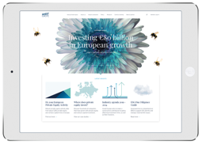
About Invest Europe
Invest Europe is the association representing Europe’s private equity, venture capital
and infrastructure sectors, as well as their investors.
European PE managed €754 billion
of capital at the end of 2020, including €283 billion of unallocated capital (‘dry powder’).
Our members take a long-term approach to investing in privately-held companies, from
start-ups to established firms. They inject
not only capital but dynamism, innovation
and expertise.
This commitment helps deliver strong and sustainable growth, resulting in healthy returns for Europe’s leading pension funds and insurers, to the benefit of the millions of European citizens who depend on them.
Invest Europe aims to make a constructive contribution to policy affecting private capital investment in Europe. We provide information
to the public on our members’ role in the economy. Our research provides the most authoritative source of data on trends and developments in our industry. And we
hold leading events and premier trainings.
Invest Europe is the guardian of the industry’s professional standards, demanding accountability, good governance and transparency from our members.
Invest Europe is a non-profit organisation
with 27 employees in Brussels, Belgium.
Our members²²
6.3 million
GP Members
LP Members
estimated number of people working for Invest Europe
members’ portfolio companies
as at end of 2019
Buyout | 161
VC | 151
Inst. Investor | 84
Fund of Funds | 65
Total 312
Total
149
8,662
active Invest Europe member portfolio companies in 2019
Associate Members
Member firms located in
€754 billion
42
15
Law Firm
Consulting/Advising
Placement Agent
3rd Party Fund Admin
Other
Capital managed by European PE
at the end of 2020, including
€283 billion of uncalled commitments
(‘dry powder’).
Total
102
countries in Europe
countries outside Europe
For more information
Please visit www.investeurope.eu
22
As at 31/12/21

Slide 47



Invest Europe
Avenue Louise 81
B-1050 Brussels
Belgium
T +32 2 715 00 20
www.investeurope.eu

